Slide 1
Lecture Notes: Color Correction

Slide 2
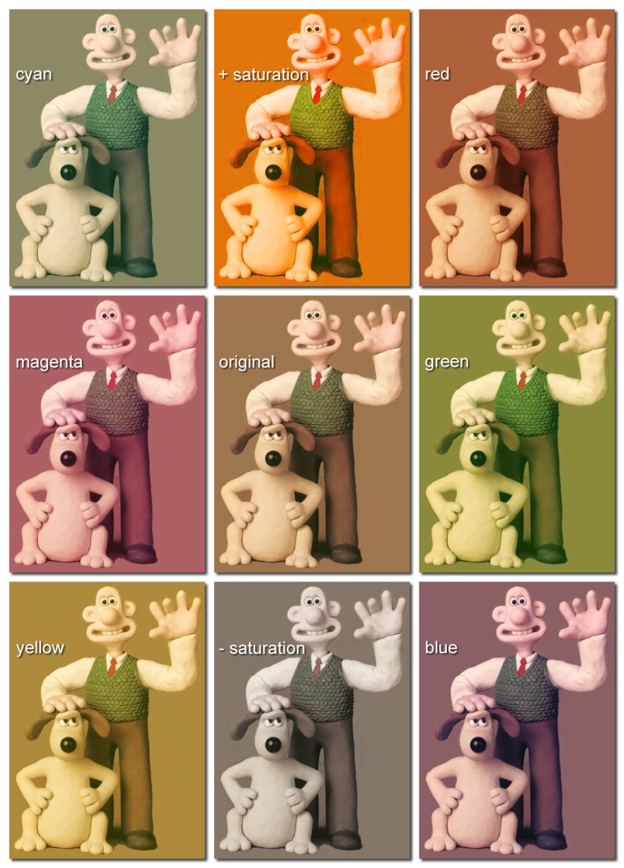
Color Correction
is a global change in the coloration of an image to alter its tint, its hues, or the saturation of its colors with minimal changes to its luminant features.

Slide 3
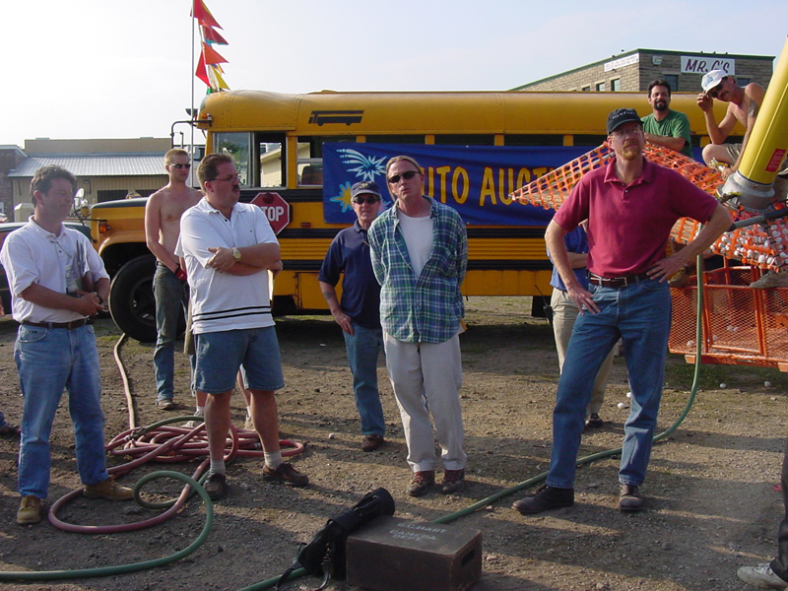
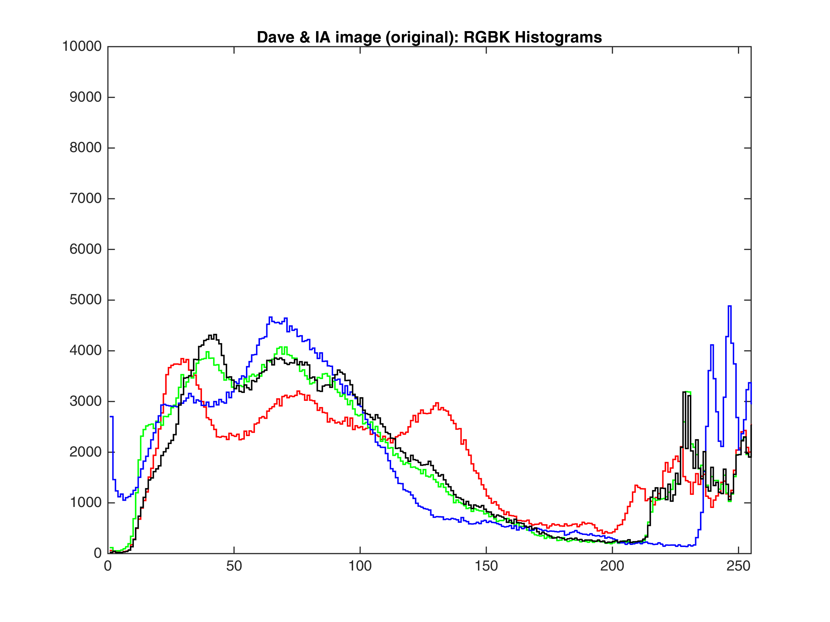

Gamma Adjustment of Color Bands
original
David Peters, producer, and representatives of the IA, The International Alliance of Theatrical Stage Employees, Moving Picture Technicians, Artists and Allied Crafts, on the set of Frozen Impact (PorchLight Entertainment, 2003).

Slide 4
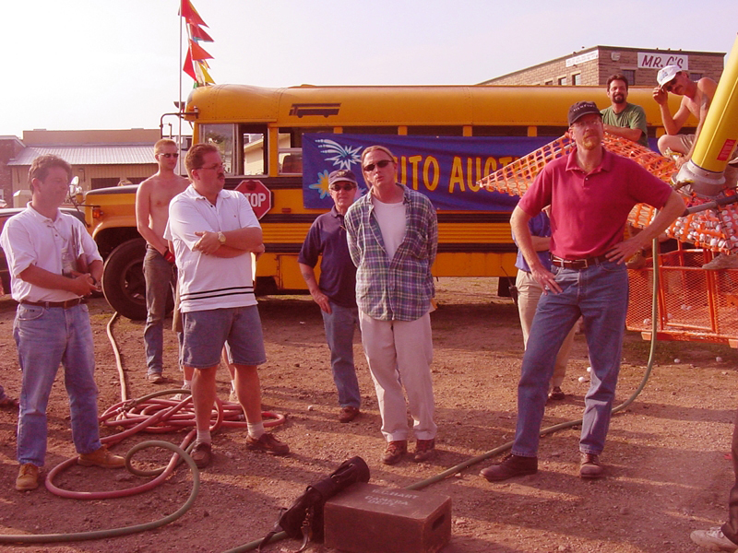
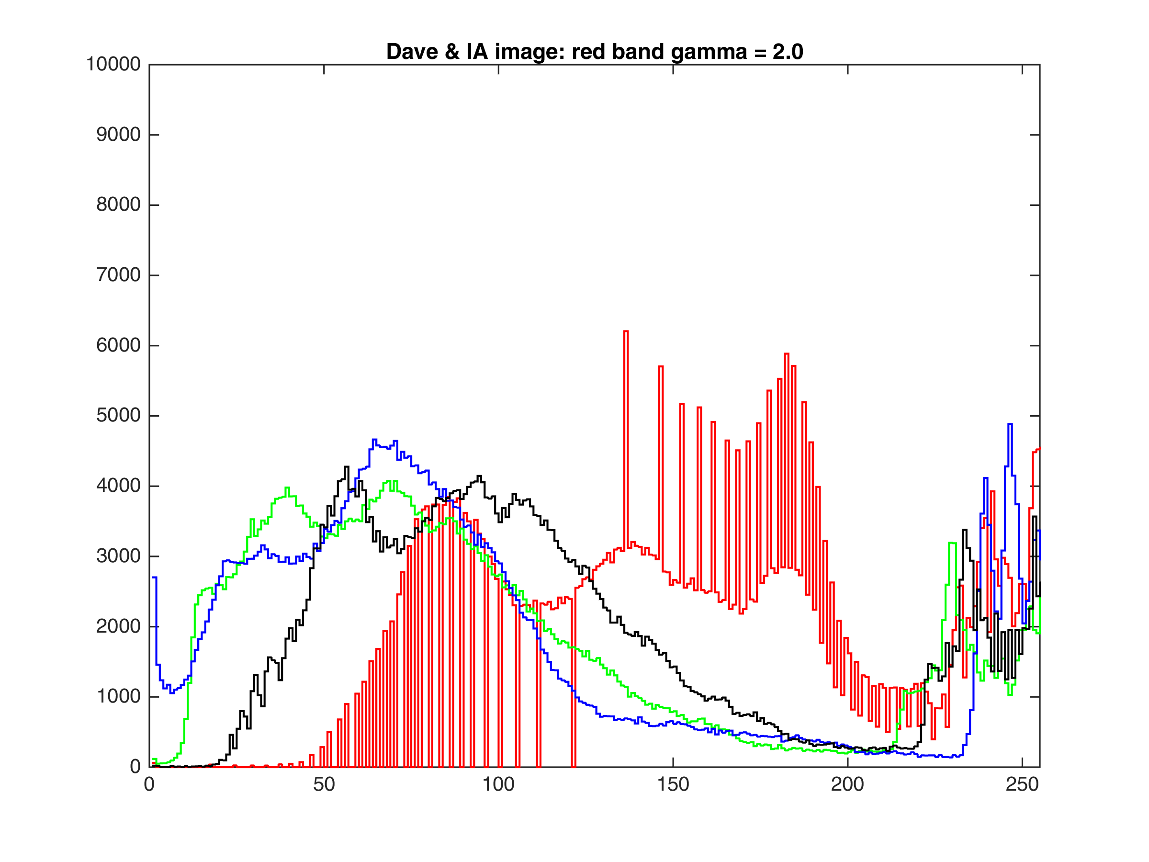
Gamma Adjustment of Color Bands
red γ=2

Slide 5
Gamma Adjustment of Color Bands
original
David Peters, producer, and representatives of the IA, The International Alliance of Theatrical Stage Employees, Moving Picture Technicians, Artists and Allied Crafts, on the set of Frozen Impact (PorchLight Entertainment, 2003).

Slide 6
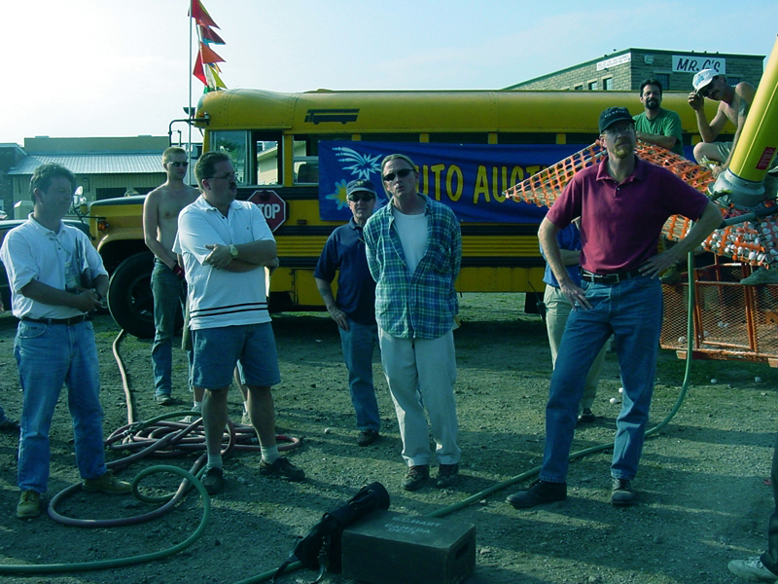
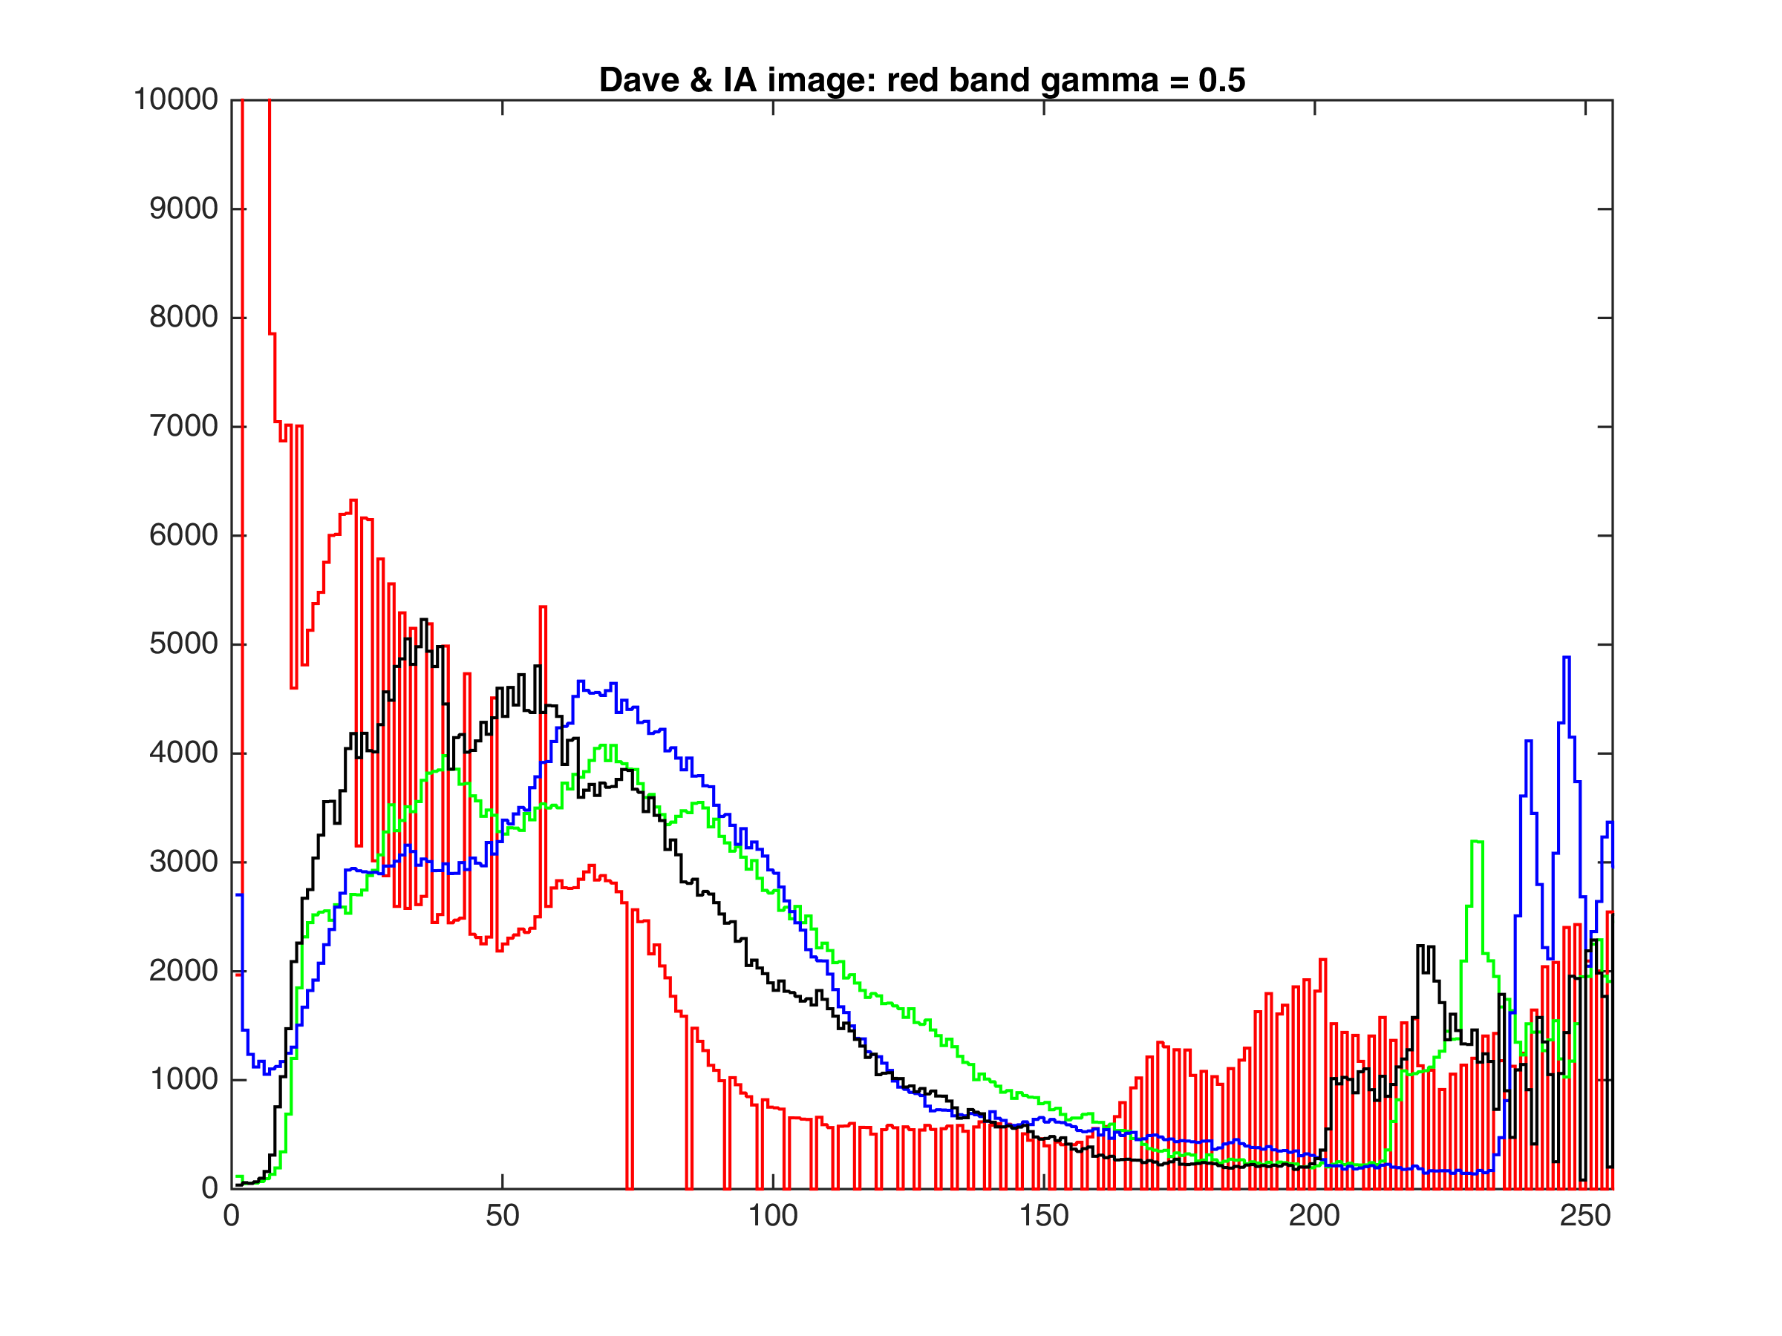
Gamma Adjustment of Color Bands
red γ=0.5
reduced red = increased cyan

Slide 7
Gamma Adjustment of Color Bands
original
David Peters, producer, and representatives of the IA, The International Alliance of Theatrical Stage Employees, Moving Picture Technicians, Artists and Allied Crafts, on the set of Frozen Impact (PorchLight Entertainment, 2003).

Slide 8
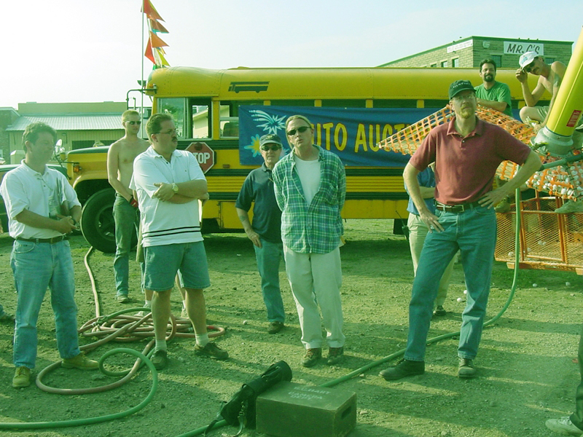
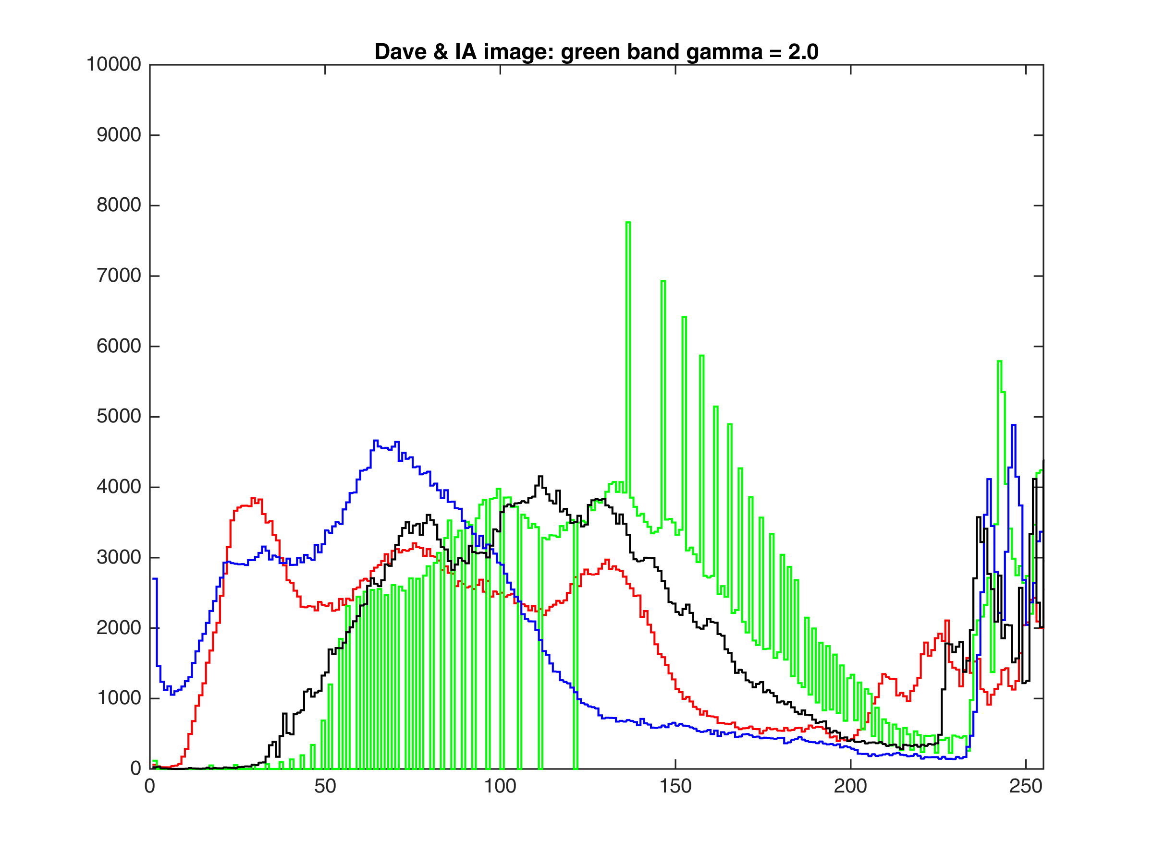
Gamma Adjustment of Color Bands
green γ=2

Slide 9
Gamma Adjustment of Color Bands
original
David Peters, producer, and representatives of the IA, The International Alliance of Theatrical Stage Employees, Moving Picture Technicians, Artists and Allied Crafts, on the set of Frozen Impact (PorchLight Entertainment, 2003).

Slide 10
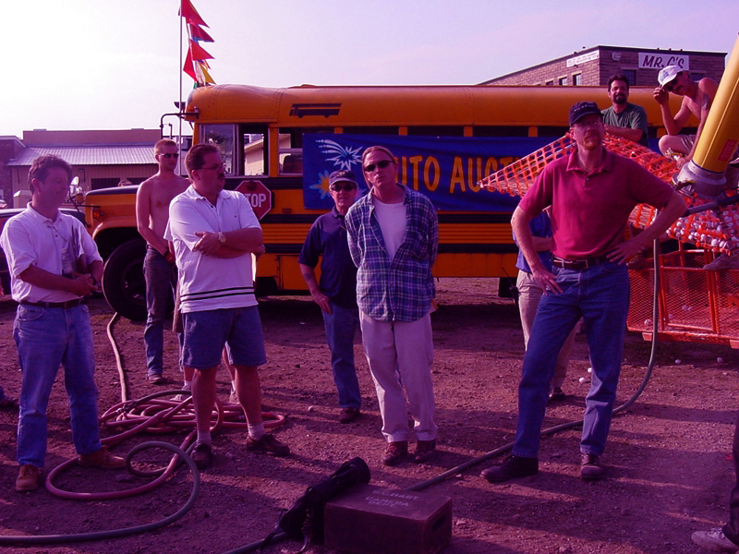
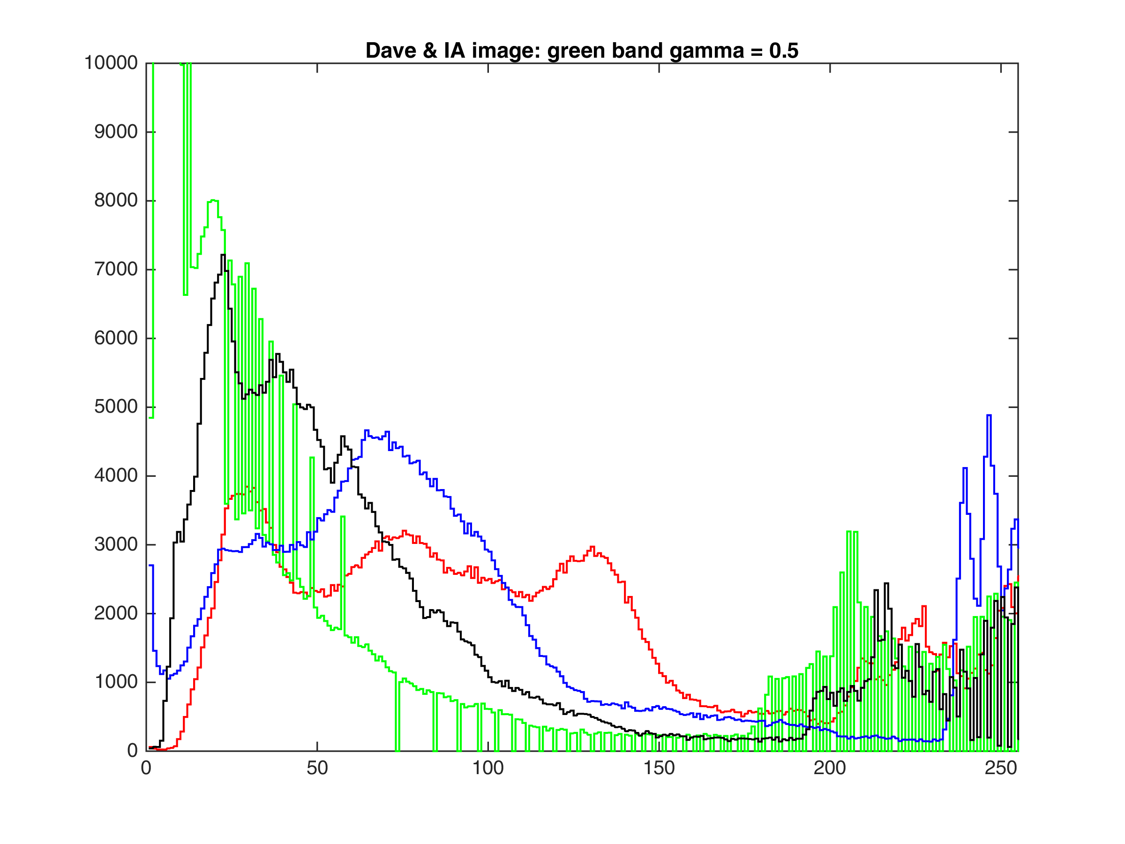
Gamma Adjustment of Color Bands
green γ=0.5
reduced green = incr. magenta

Slide 11
Gamma Adjustment of Color Bands
original
David Peters, producer, and representatives of the IA, The International Alliance of Theatrical Stage Employees, Moving Picture Technicians, Artists and Allied Crafts, on the set of Frozen Impact (PorchLight Entertainment, 2003).

Slide 12
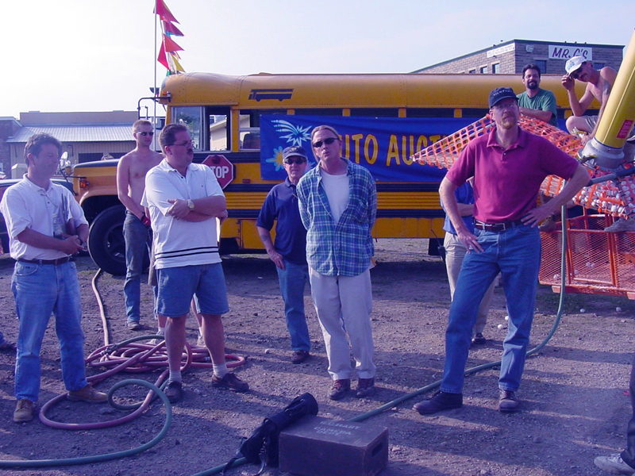
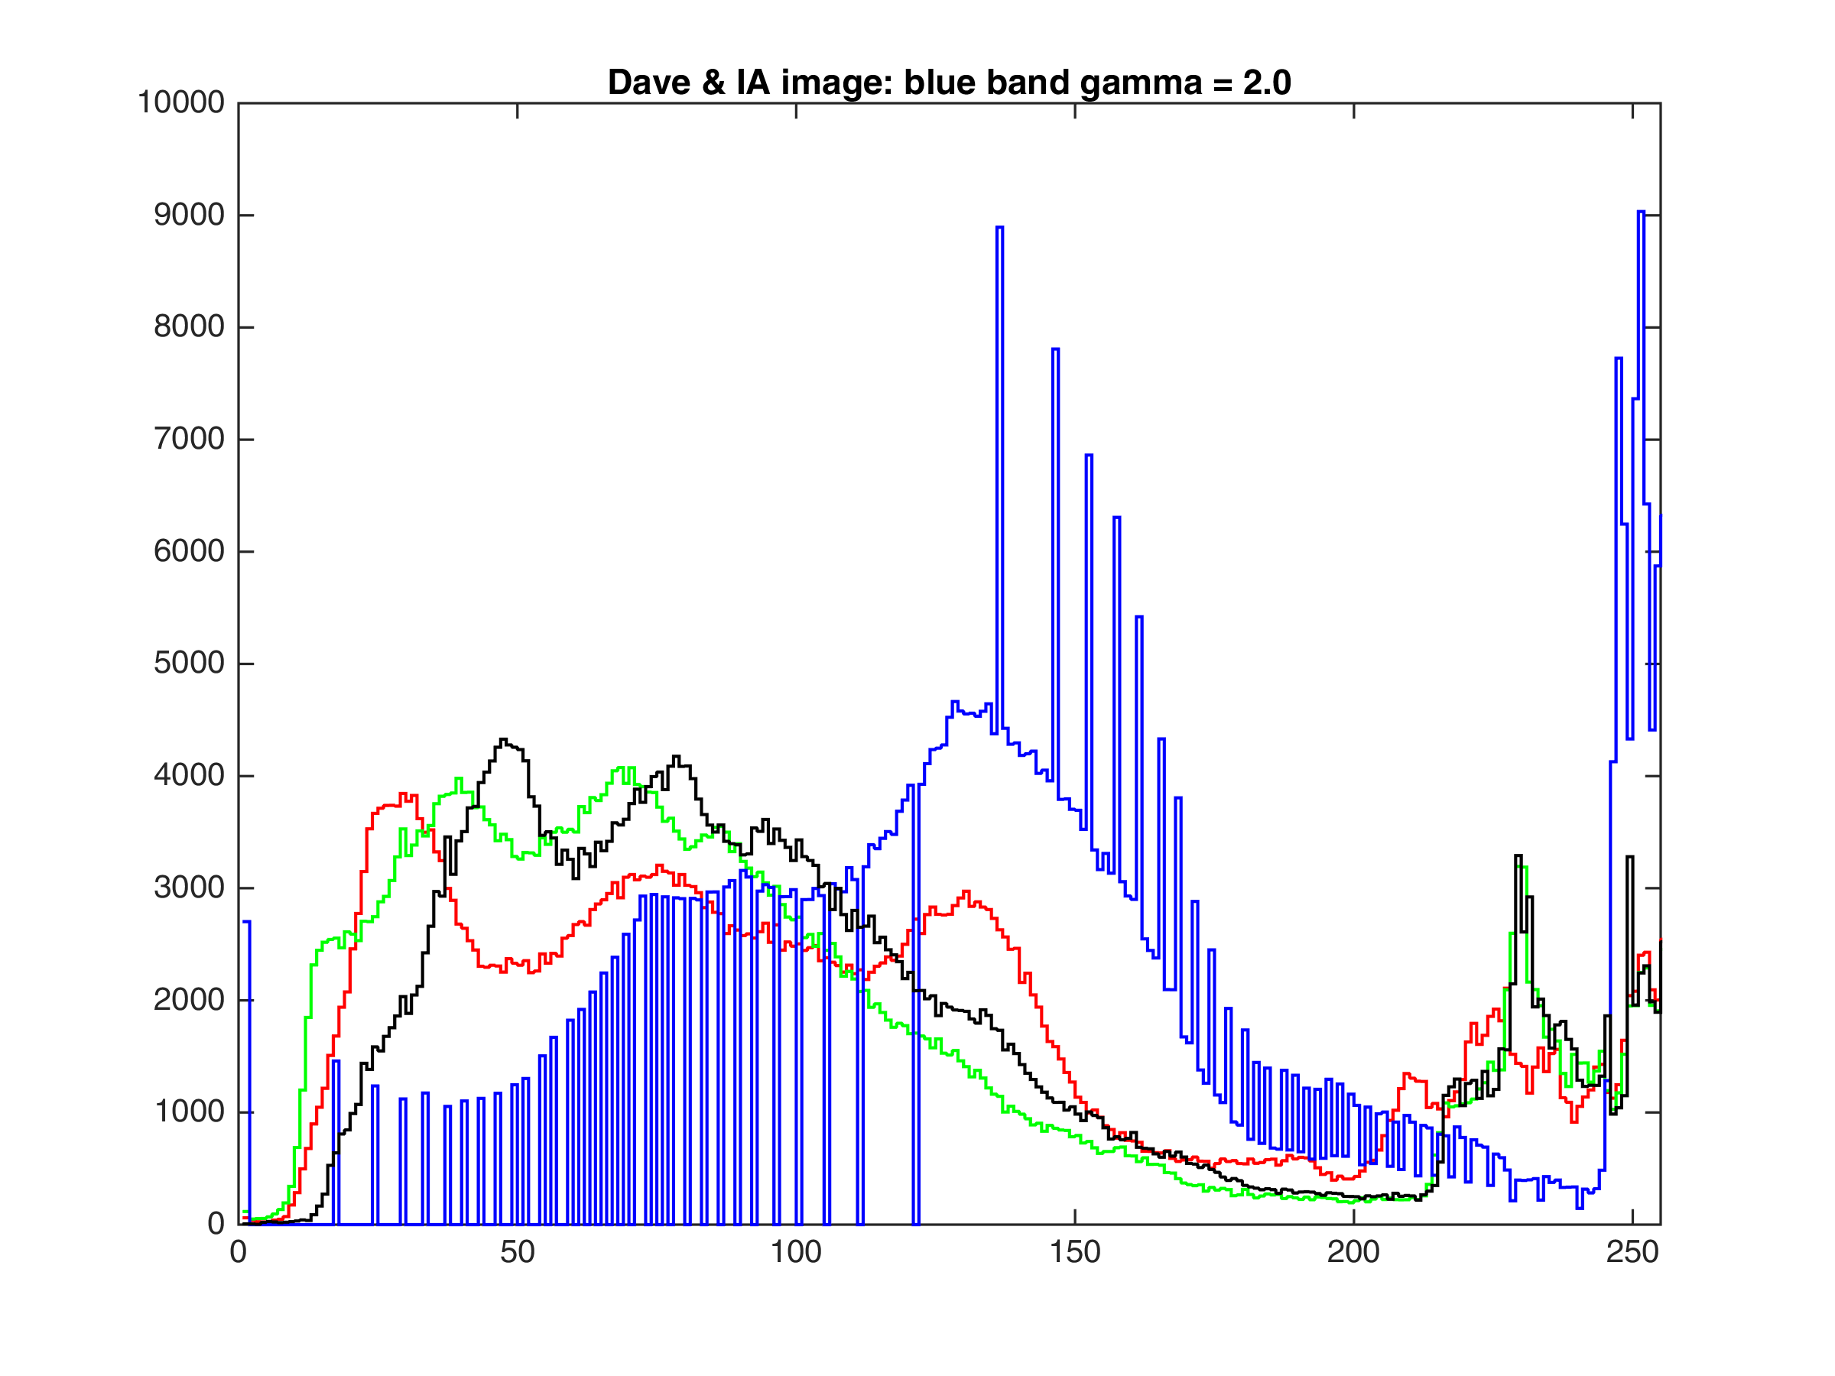
Gamma Adjustment of Color Bands
blue γ=2

Slide 13
Gamma Adjustment of Color Bands
original
David Peters, producer, and representatives of the IA, The International Alliance of Theatrical Stage Employees, Moving Picture Technicians, Artists and Allied Crafts, on the set of Frozen Impact (PorchLight Entertainment, 2003).

Slide 14
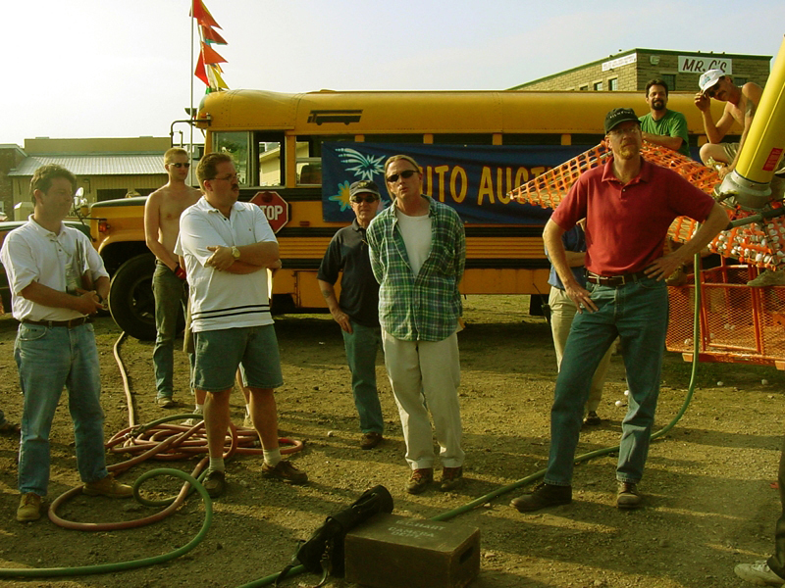
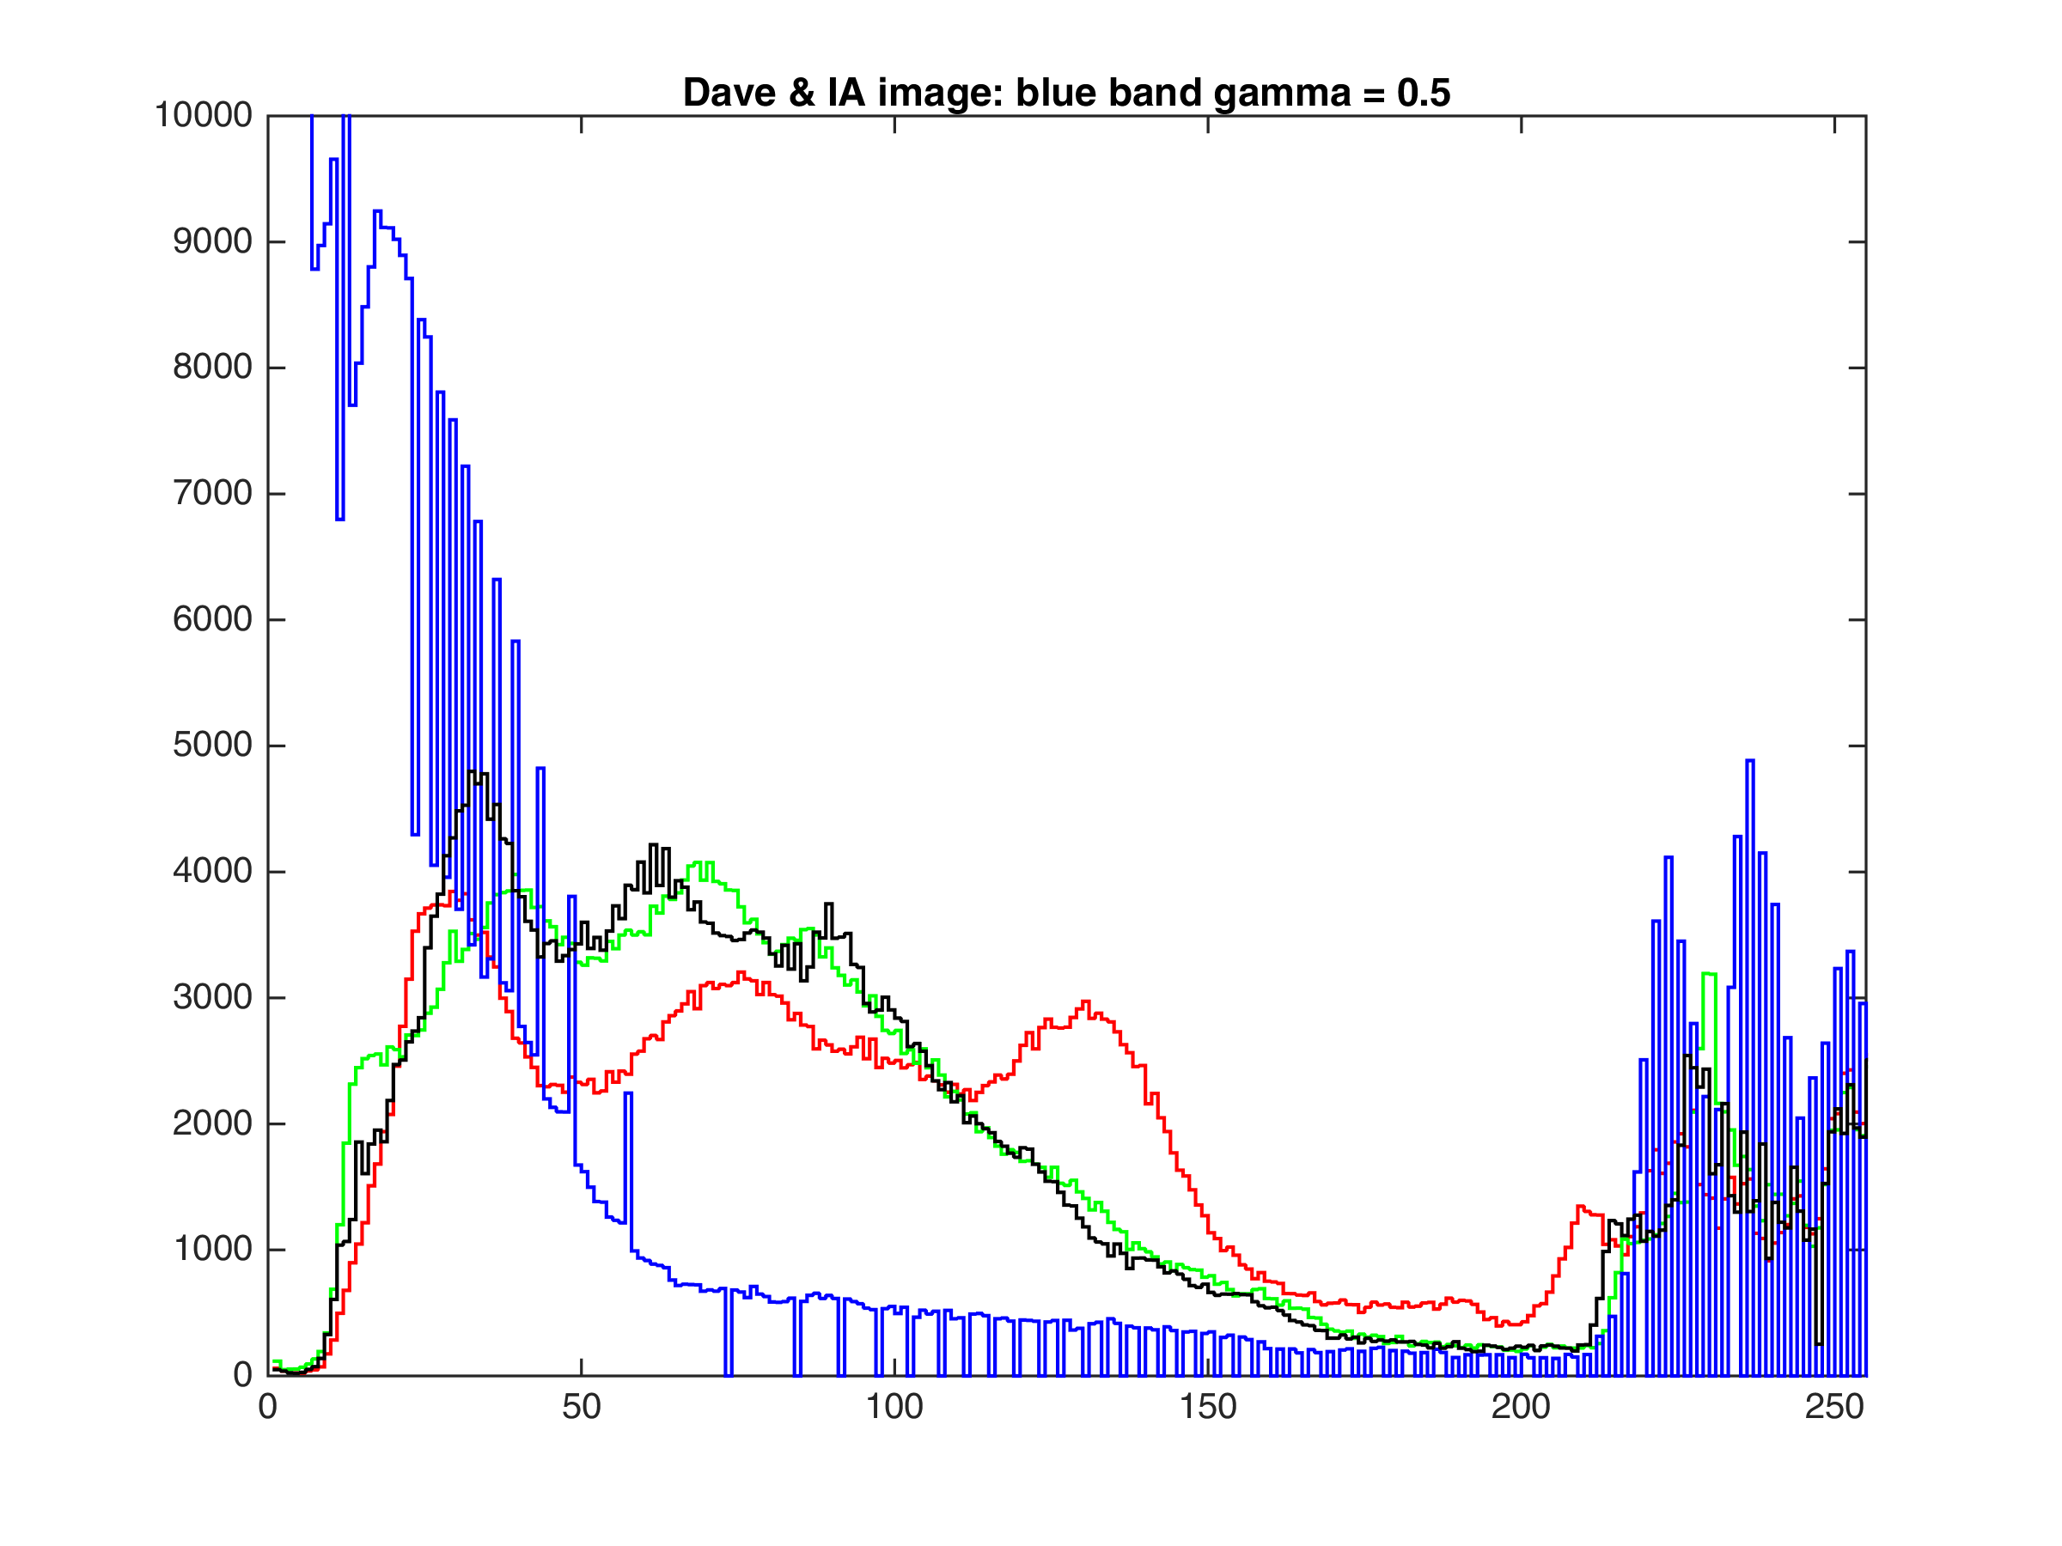
Gamma Adjustment of Color Bands
blue γ=0.5
reduced blue = incr. yellow

Slide 15
Gamma Adjustment of Color Bands
original
David Peters, producer, and representatives of the IA, The International Alliance of Theatrical Stage Employees, Moving Picture Technicians, Artists and Allied Crafts, on the set of Frozen Impact (PorchLight Entertainment, 2003).

Slide 16
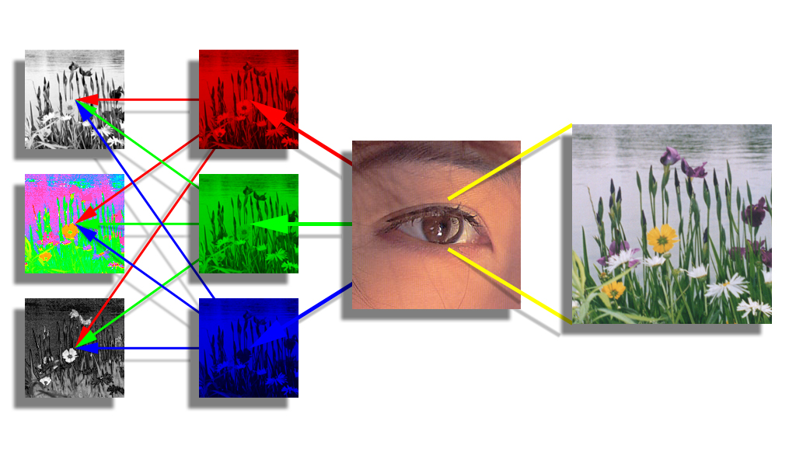
RGB to LHS: A Perceptual Transformation
luminance
The eye has 3 types of photoreceptors:
sensitive to red, green, or blue light.
hue
saturation
The brain transforms RGB into separate brightness and color channels (e.g., LHS).
brain
photo receptors

Slide 17
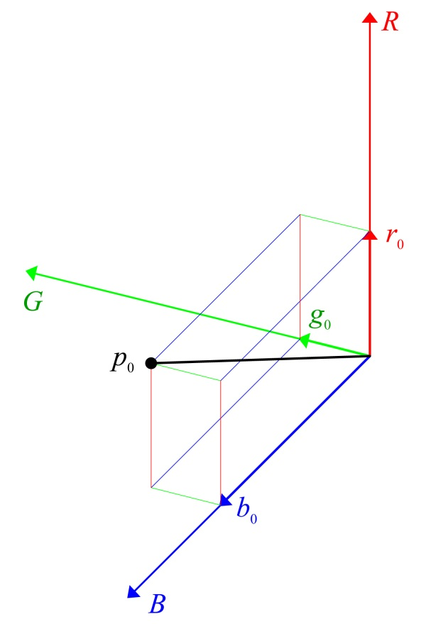
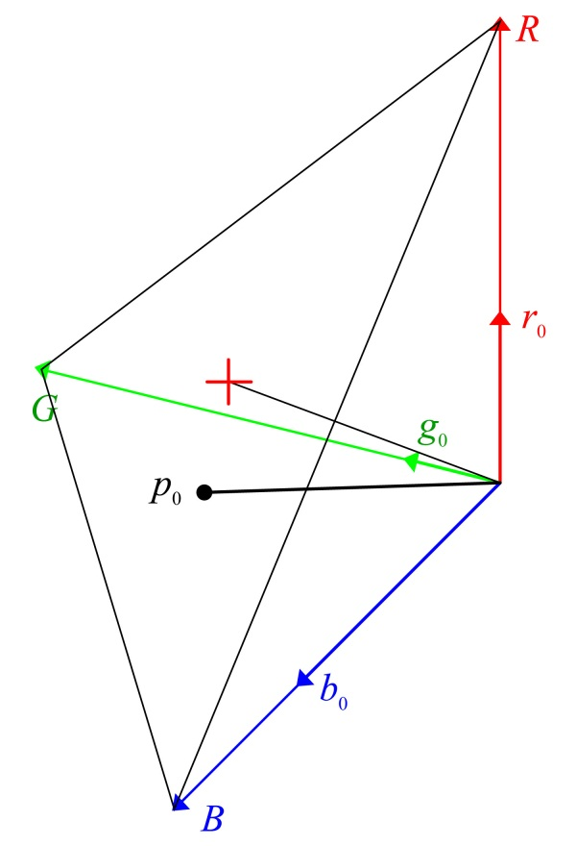
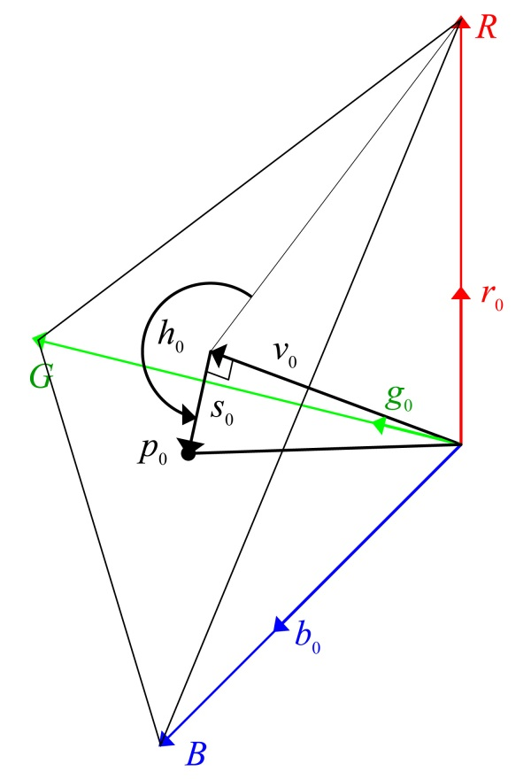
HSV Color Representation
+ marks the spot where R=G=B= (r0+g0+b0)/3
Color vector p0
p0 = (r0, g0, b0)
Triangle:
lies in plane R+G+B=(r₀+g₀+b₀),
intersects R, G, & B axes at r₀+g₀+b₀, and contains p₀.

Slide 18
RGB to HSV Algorithm
|| ⋅ || is the norm operator – the square root of the pixel-wise sum of the squares of the image intensity components.
A vector-geometric algorithm
Compute scalar value image, v, from RGB image, I=[r g b]^{T}.
Compute vector value image, V = [v v v]^{T}.
Compute vector saturation image, S = I - V.
Compute scalar saturation image, s = || S ||.
Compute red axis vector image, X = [2v –v –v]^{T}.
Compute red axis scalar image, x = || X ||.
Create an indicator image, z(r,c) = s(r,c)==0.
Compute hue cosine image, c = (S•X)/((s+z)⋅x).
Compute hue angle image, h = cos⁻¹(c).
Create an indicator image, m(r,c) = b(r,c) > g(r,c).
Adjust h = ~m⋅h + m⋅(2pi-h).
Scale s = s / 208.2066.
Return [h s v]^{T}.
S•X is the pixel-wise dot product of images S & X.
z and m are binary images z(r,c)==1 iff s(r,c)==0; m(r,c)==1 iff b(r,c) > g(r,c).

Slide 19
HSV to RGB Conversion
The x, y, & z unit vectors in r, g, & b coordinates are the columns of the rotation matrix:
Therefore, the rotation matrix is
Substitute that into the 2nd equation on slide 94 to get:
v0
s0
p0
Finally, [s]rgb must be translated to the value vector to obtain the rgb color of p0:
where s0 = [s]rgb and [v]rgb= v0 as def ’d. on slide 81.

Slide 20
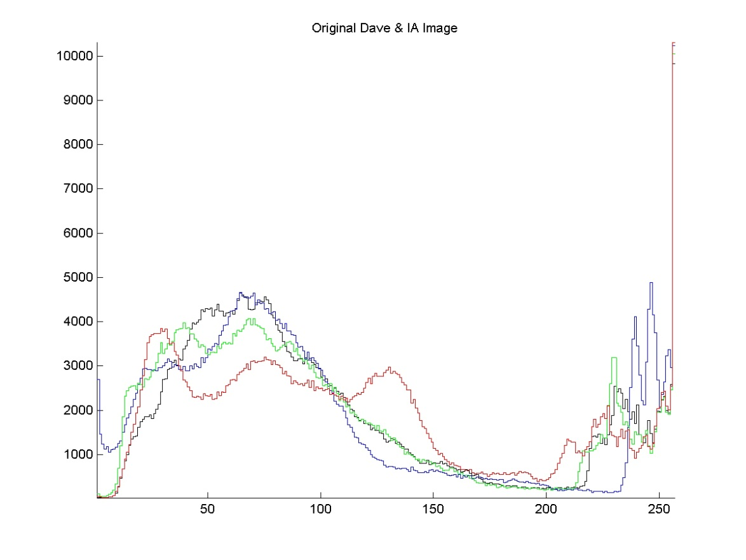
Saturation Adjustment
original

Slide 21
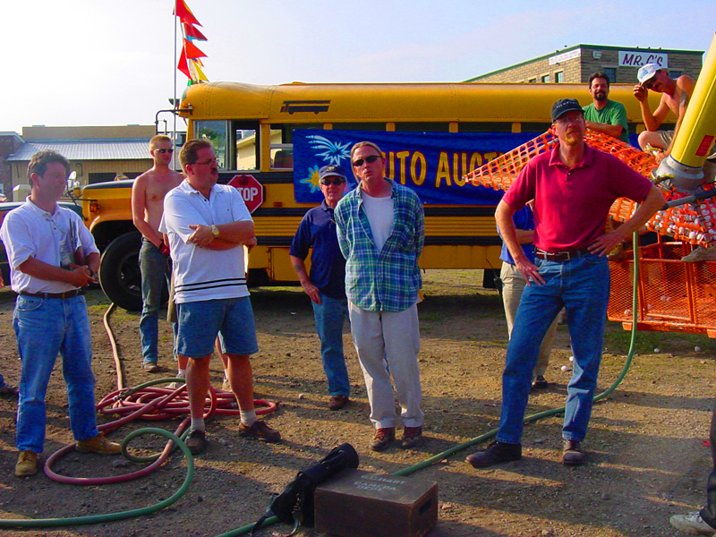
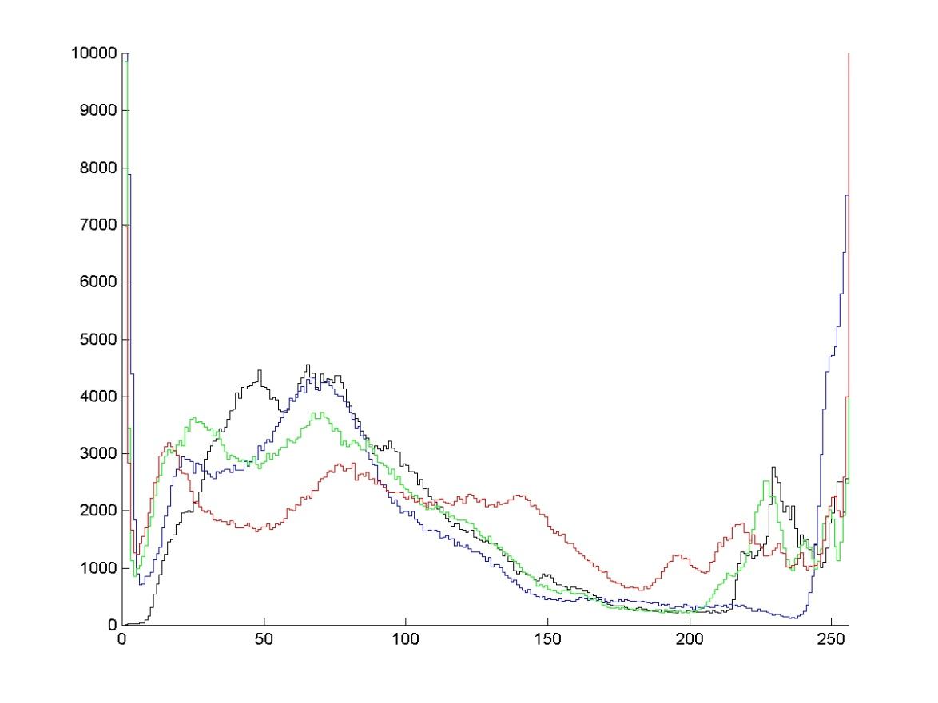
Saturation Adjustment
saturation + 50%
All the colors become closer to pure primaries.

Slide 22
Saturation Adjustment
original

Slide 23

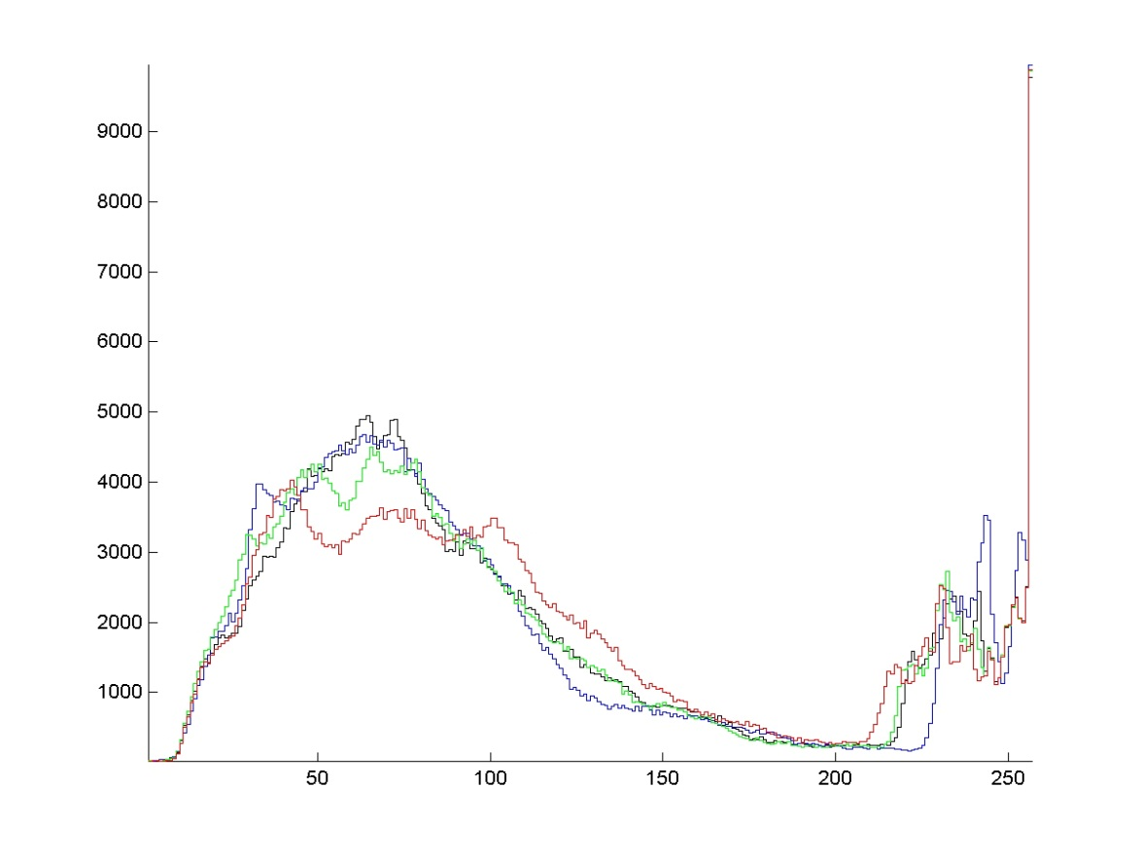
Saturation Adjustment
saturation - 50%
The r, g, & b histograms approach the value histogram as the color fades to grayscale.

Slide 24
Hue Shifting
R
Y
G
C
B
M
→
→
→
→
→
→
R
Y
G
C
B
M
original

Slide 25
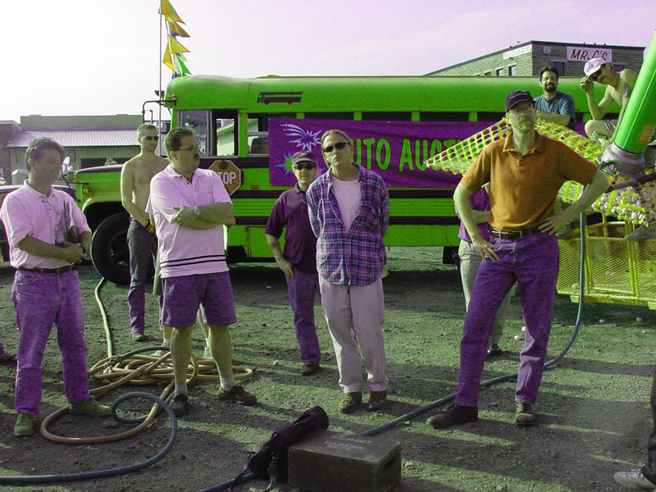
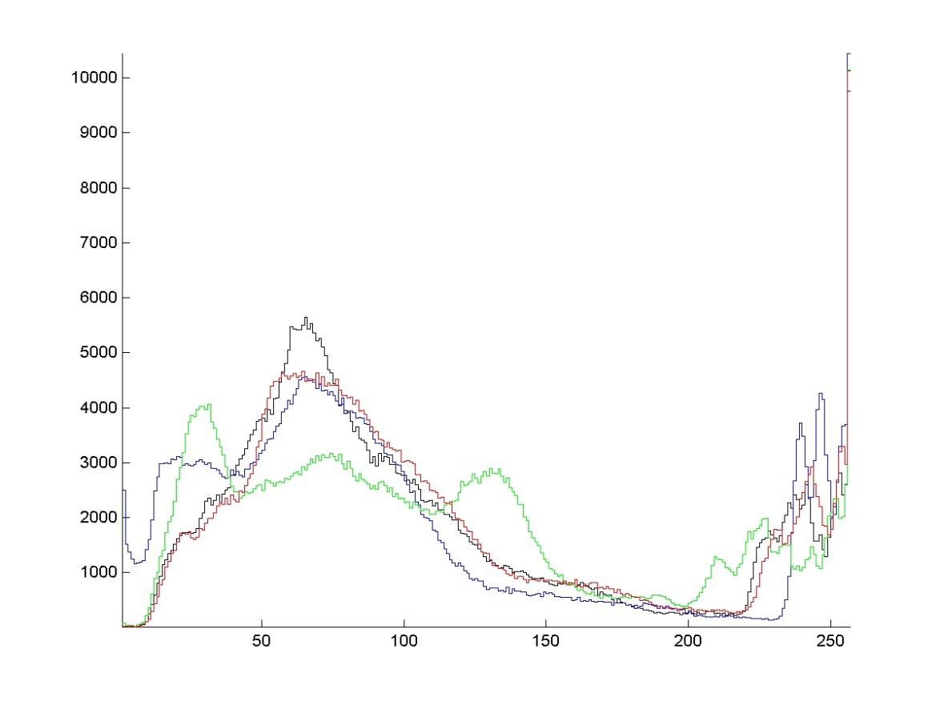
Hue Shifting
R
Y
G
C
B
M
→
→
→
→
→
→
Y
G
C
B
M
R
hue + 60°
The effects of a hue shift are nonlinear. They difficult to characterize on the r, g, & b histograms

Slide 26
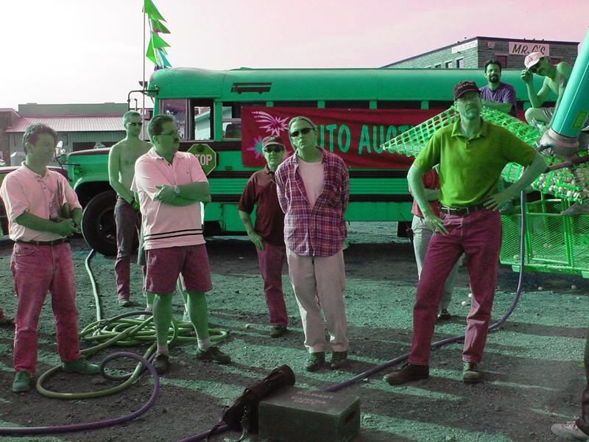
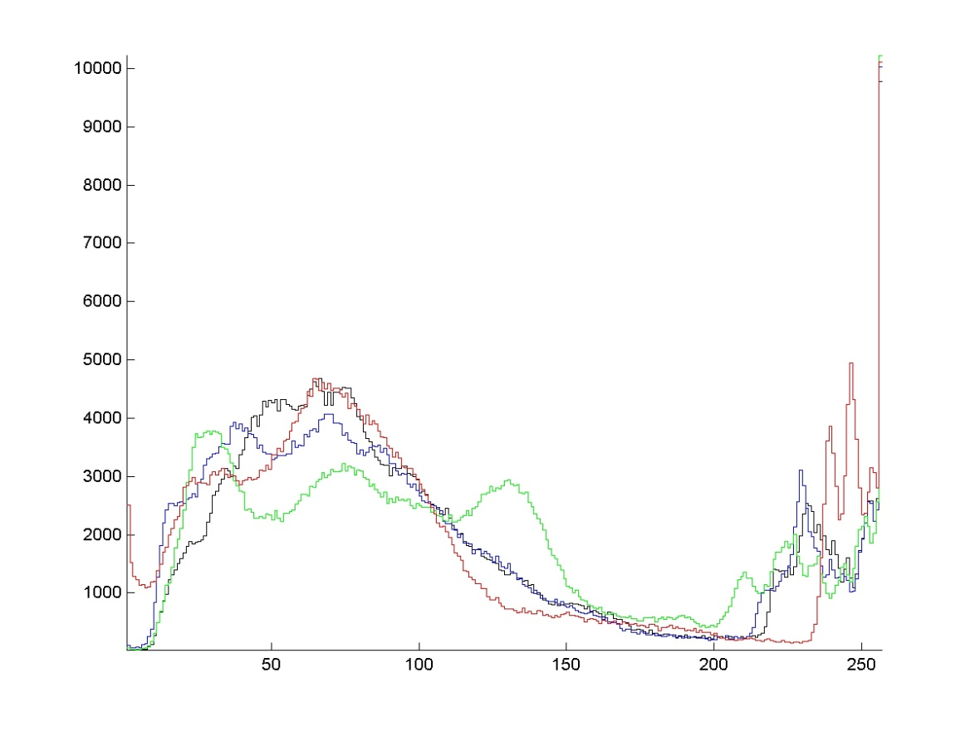
Hue Shifting
R
Y
G
C
B
M
→
→
→
→
→
→
G
C
B
M
R
Y
hue + 120°

Slide 27
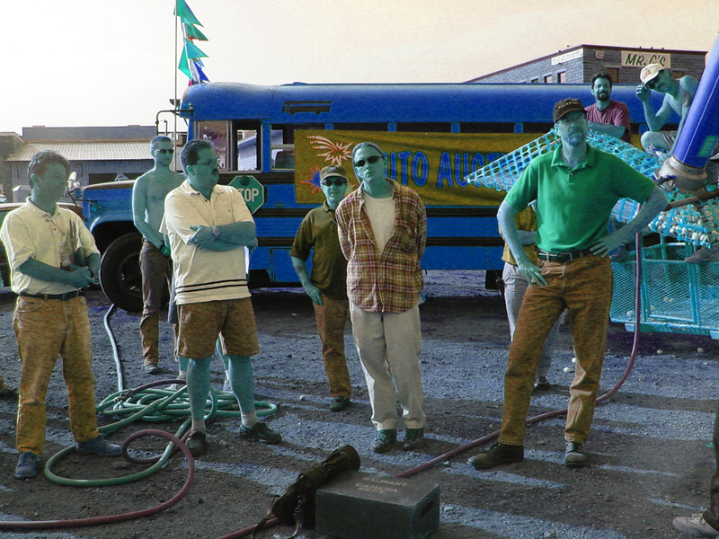
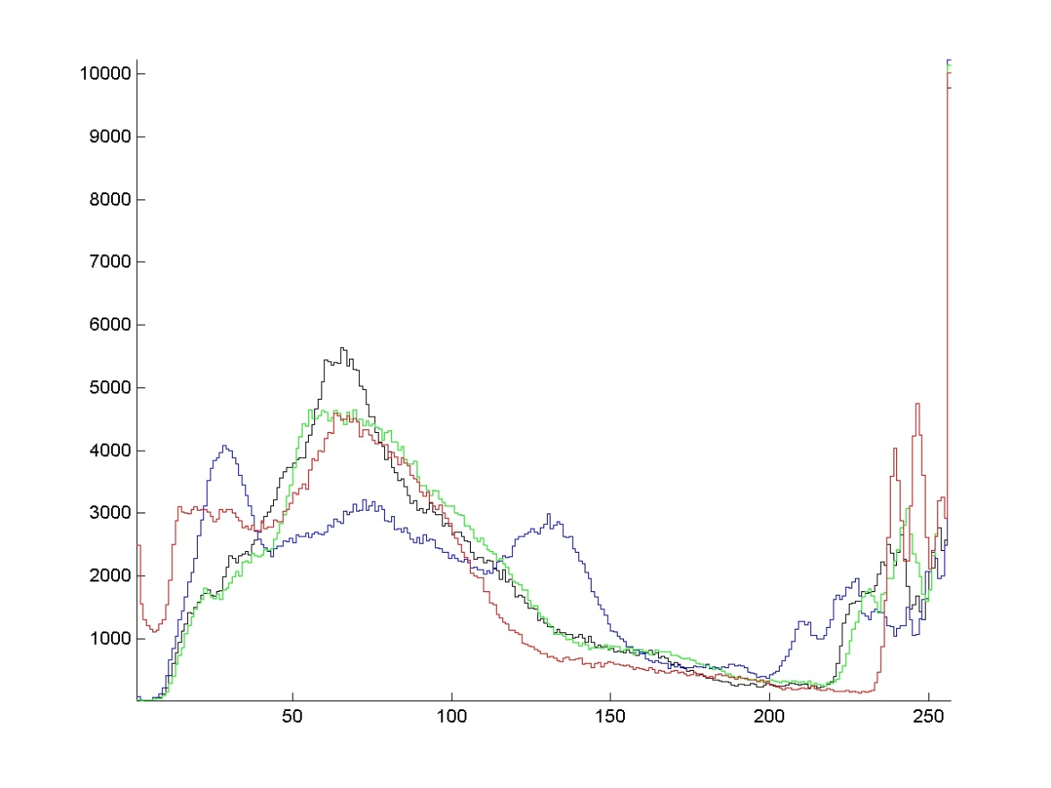
Hue Shifting
R
Y
G
C
B
M
→
→
→
→
→
→
C
B
M
R
Y
G
hue + 180°

Slide 28
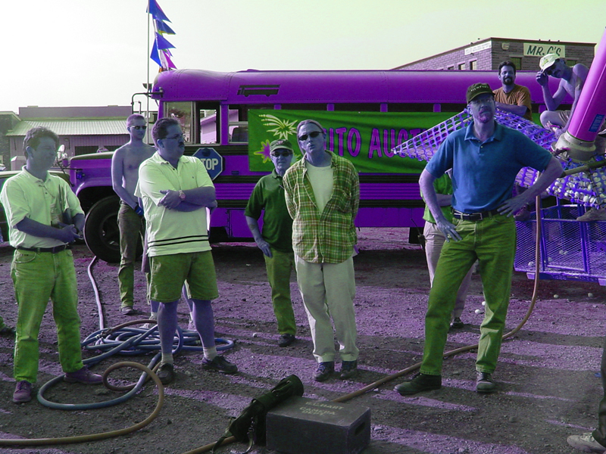
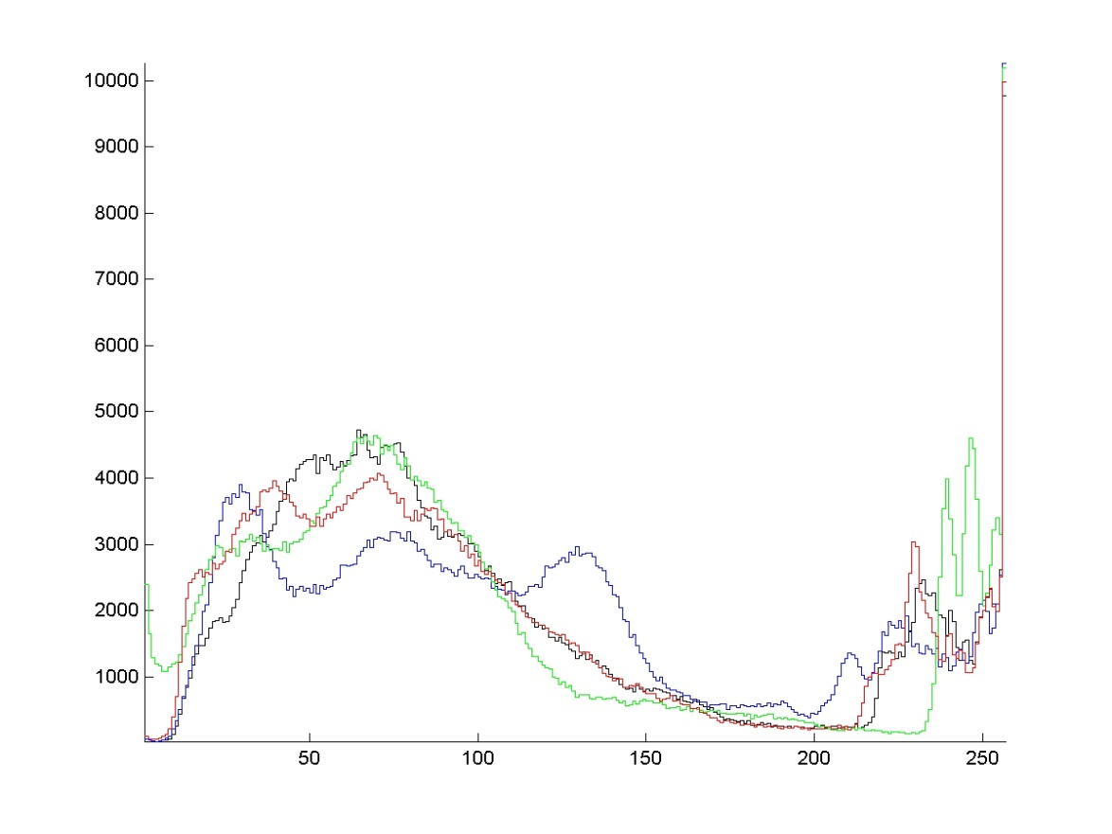
Hue Shifting
R
Y
G
C
B
M
→
→
→
→
→
→
B
M
R
Y
G
C
hue + 240°

Slide 29
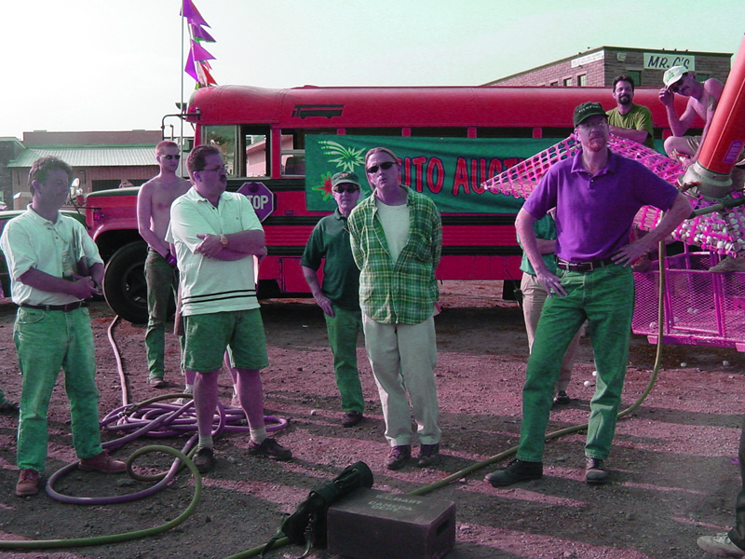
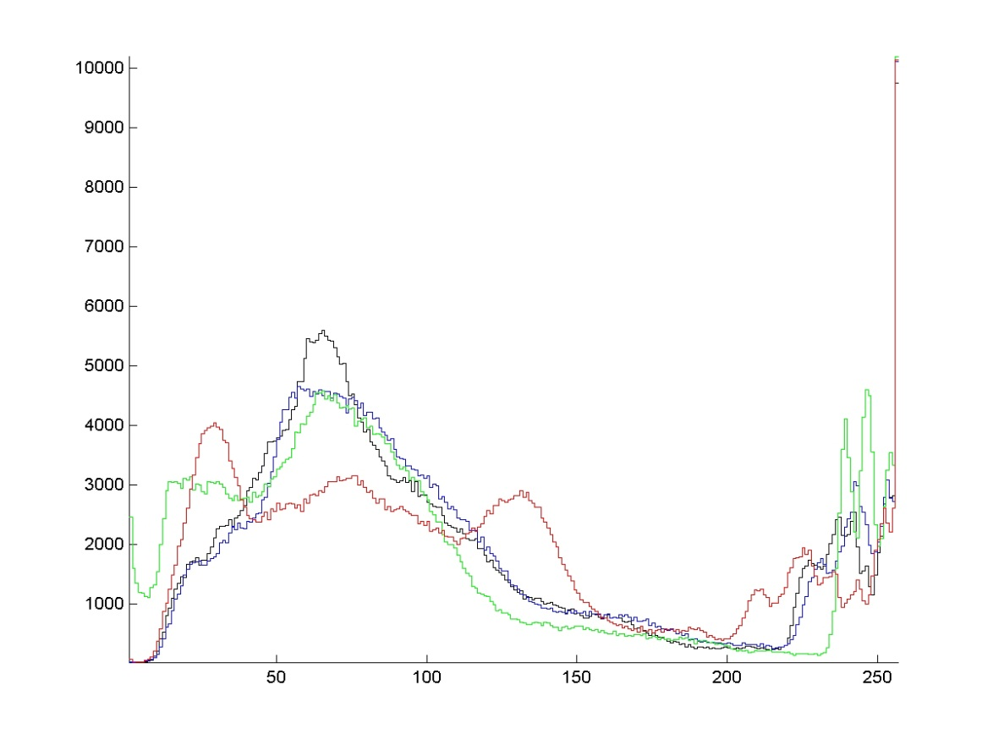
Hue Shifting
R
Y
G
C
B
M
→
→
→
→
→
→
M
R
Y
G
C
B
hue + 300°

Slide 30
Hue Shifting
R
Y
G
C
B
M
→
→
→
→
→
→
R
Y
G
C
B
M
hue + 360° = original

Slide 31
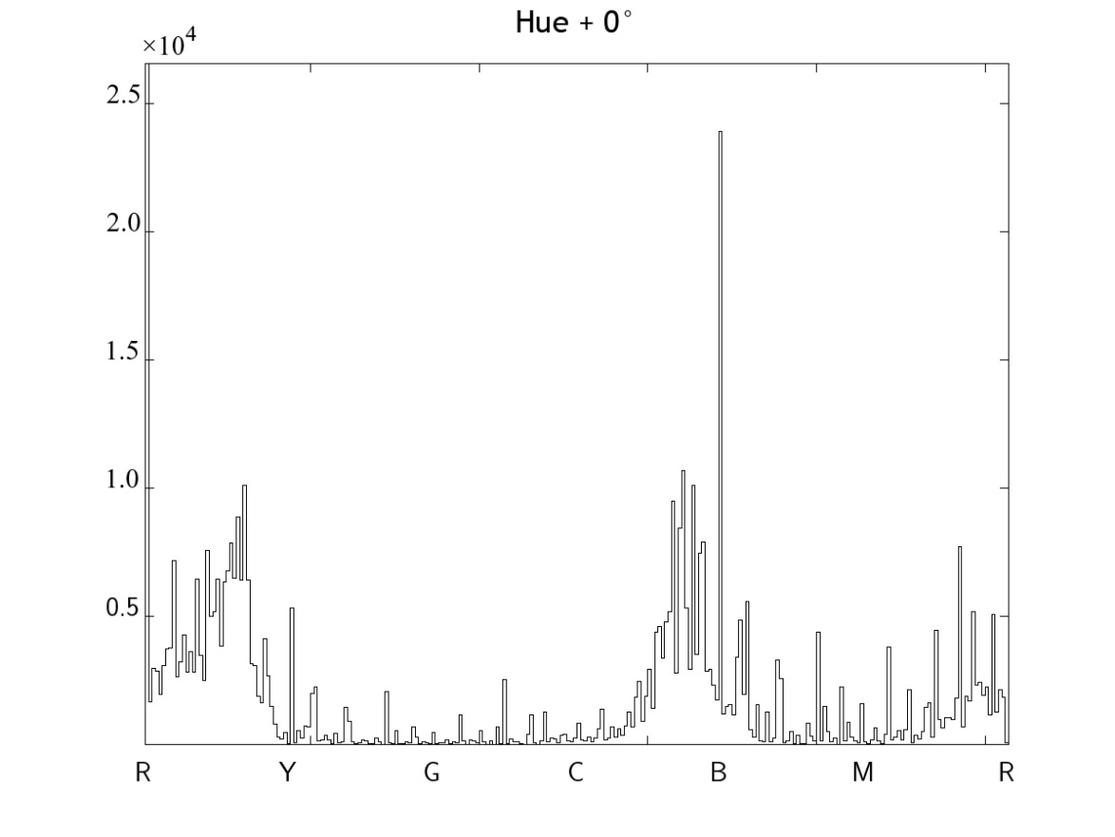
Hue Shifting
R
Y
G
C
B
M
→
→
→
→
→
→
R
Y
G
C
B
M
original
The effect of a hue shift on the hue histogram is quite obvious…

Slide 32
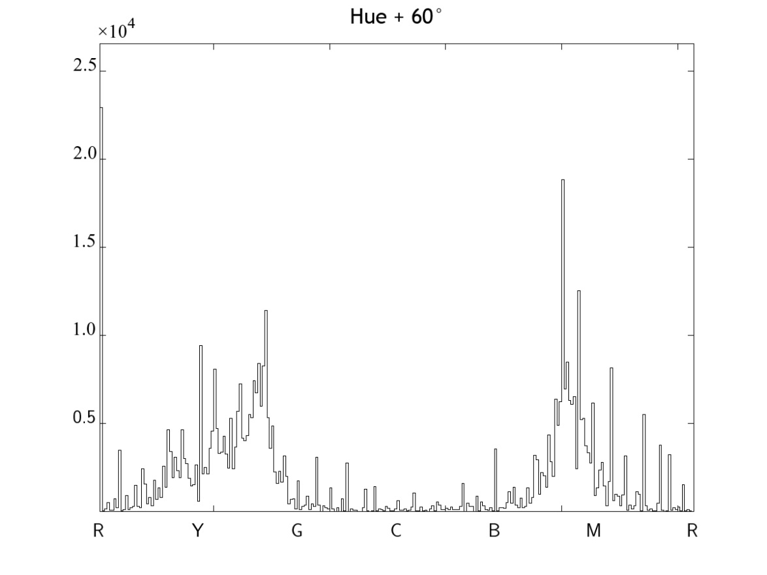
Hue Shifting
R
Y
G
C
B
M
→
→
→
→
→
→
Y
G
C
B
M
R
hue + 60°
… the entire histogram is shifting…

Slide 33
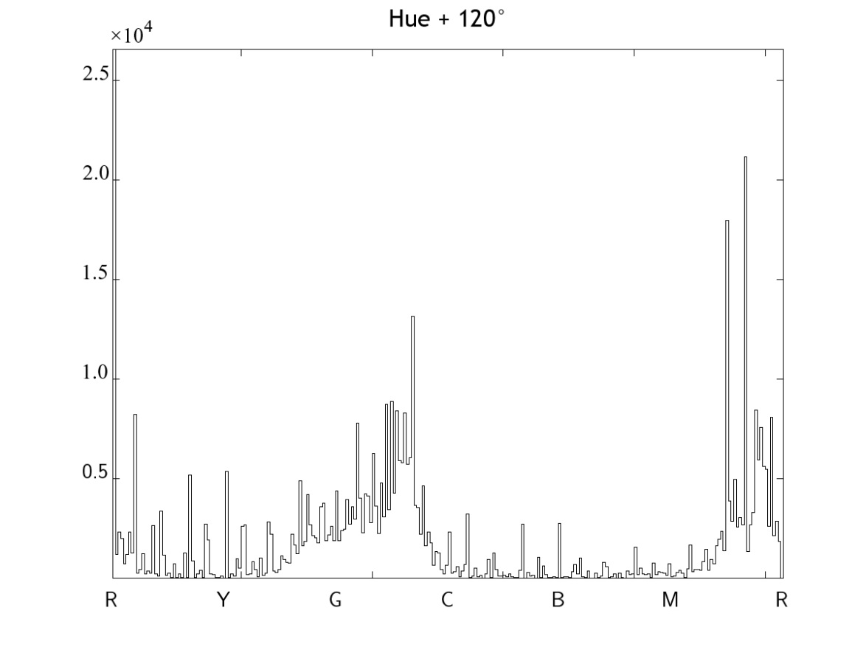
Hue Shifting
R
Y
G
C
B
M
→
→
→
→
→
→
G
C
B
M
R
Y
hue + 120°
… and the shift is circular since the hue is a circular function – it is defined on a circle.

Slide 34
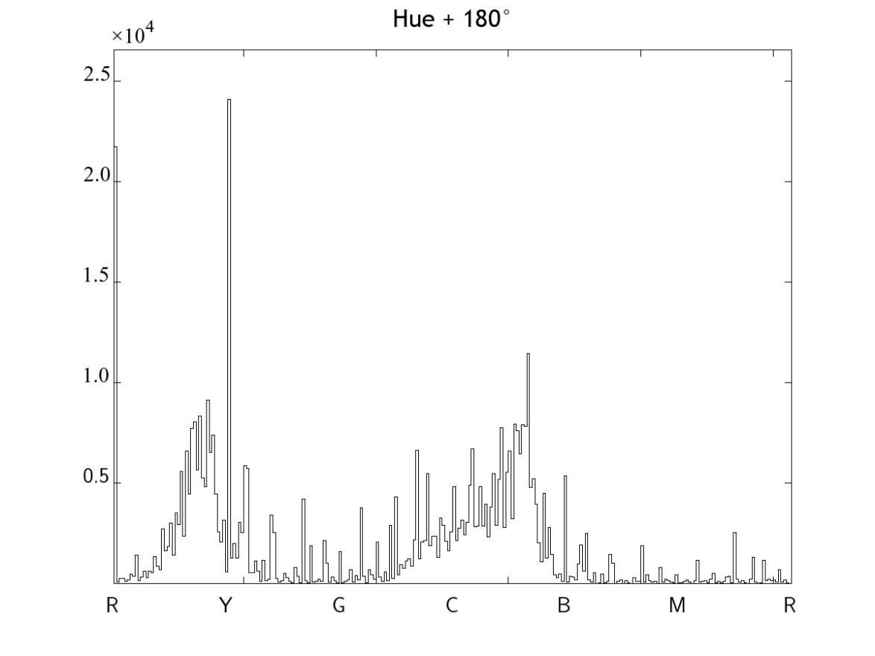
Hue Shifting
R
Y
G
C
B
M
→
→
→
→
→
→
C
B
M
R
Y
G
hue + 180°
The part of the histogram that leaves one side appears on the other.

Slide 35
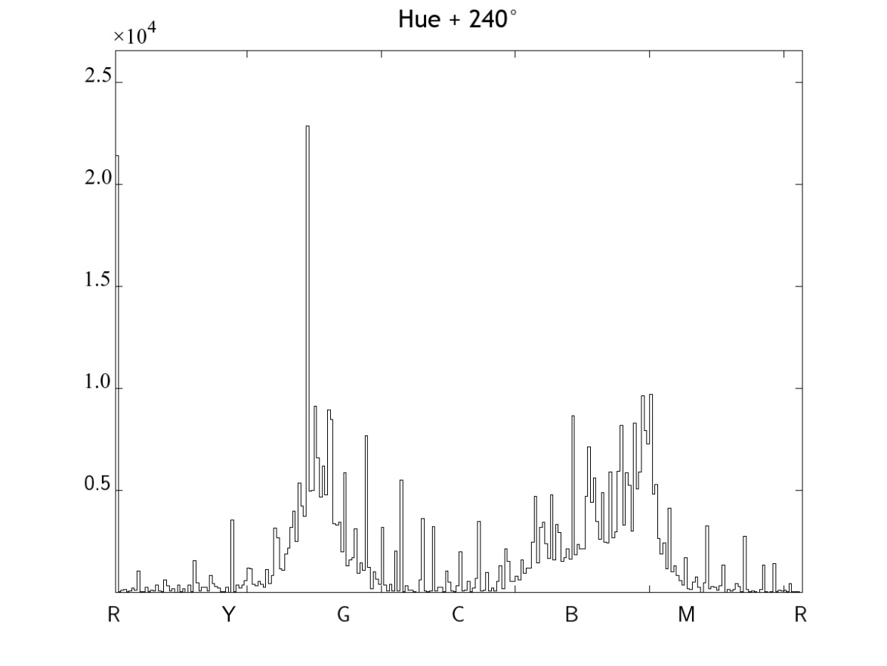
Hue Shifting
R
Y
G
C
B
M
→
→
→
→
→
→
B
M
R
Y
G
C
hue + 240°

Slide 36
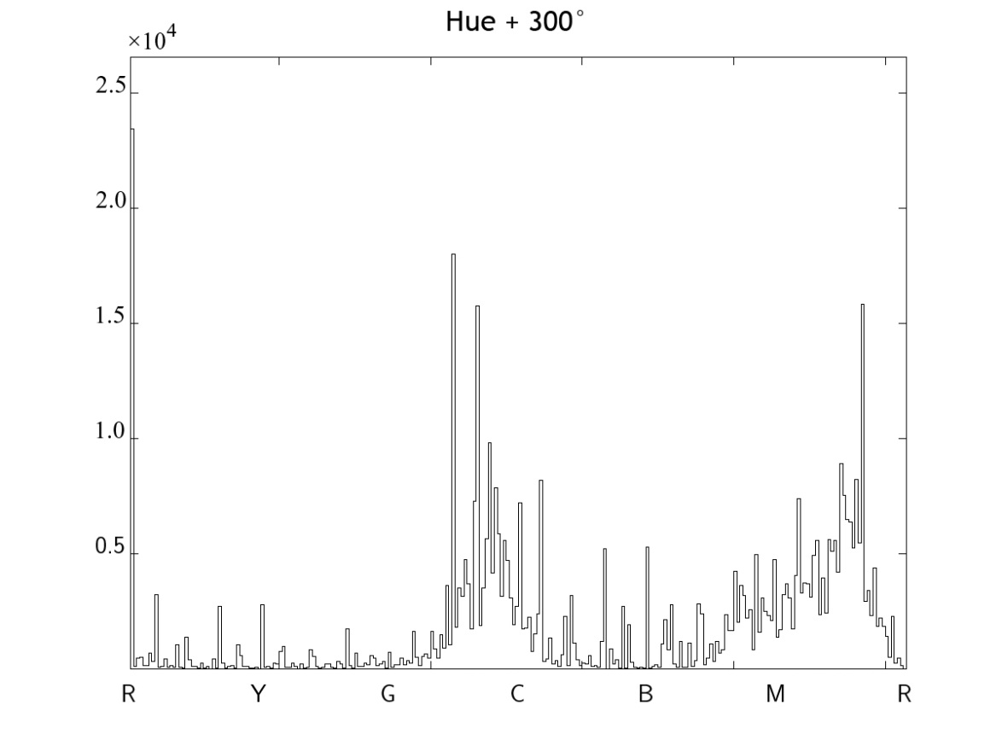
Hue Shifting
R
Y
G
C
B
M
→
→
→
→
→
→
M
R
Y
G
C
B
hue + 300°

Slide 37
Hue Shifting
R
Y
G
C
B
M
→
→
→
→
→
→
R
Y
G
C
B
M
hue + 360° = original

Slide 38
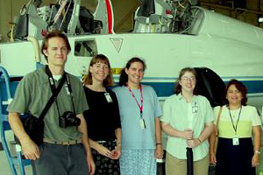
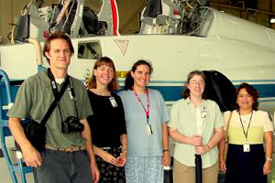
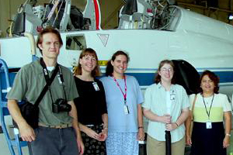
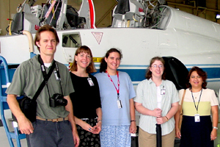
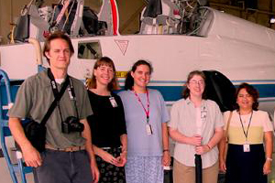
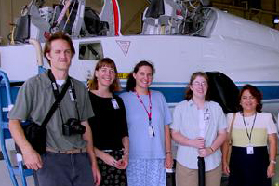
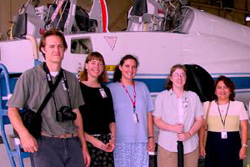
Linear Transformation of Color
green
yellow
cyan
original
red
blue
magenta

Slide 39
Color Correction via Linear Transformation
is a point process; the transformation is applied to each pixel as a function of its color alone.
Each pixel is vector valued, therefore the transformation is a vector space operator.

Slide 40
Color Vector Space Operators
Linear operators are matrix multiplications
Example of a nonlinear operator: gamma correction

Slide 41
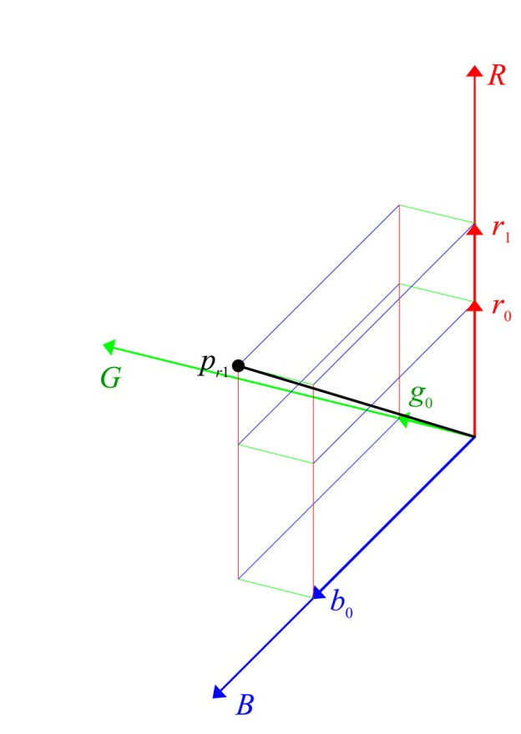
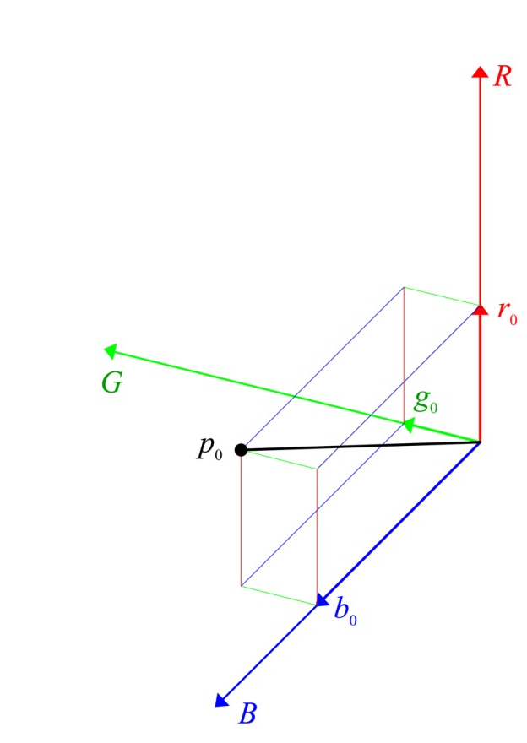
Linear Transformation of Color
175
75
175
125
75
175

Slide 42
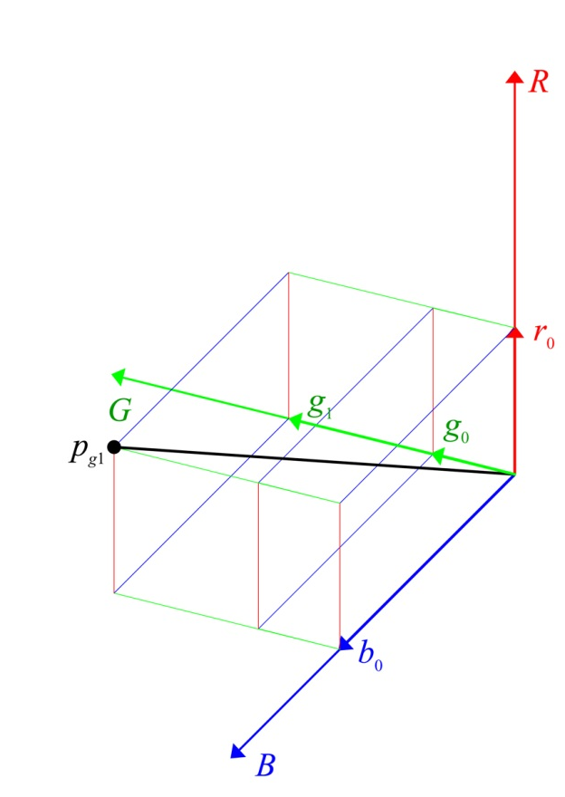
Linear Transformation of Color
125
150
175
125
75
175

Slide 43
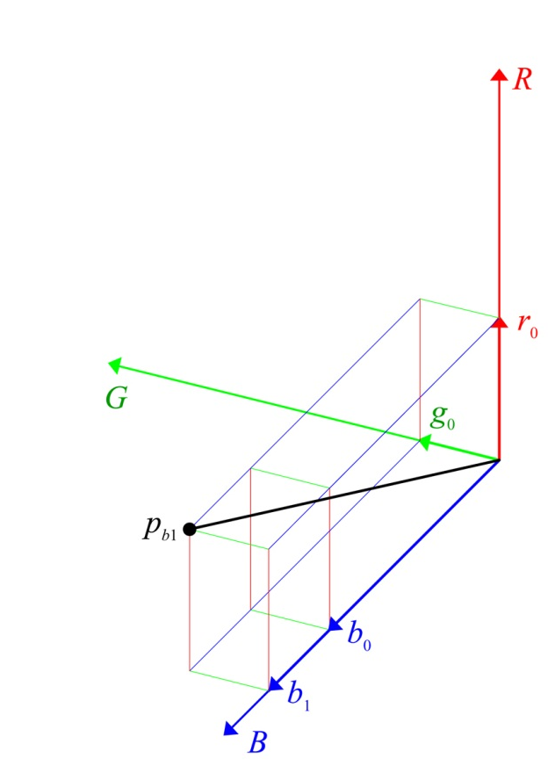
Linear Transformation of Color
125
75
225
125
75
175

Slide 44

Linear Transformation of Color
175
150
225
125
75
175

Slide 45
Color Transformation
Assume J is a discolored version of image I such that J = Φ[ I ]. If Φ is linear then it is represented by a 3×3 matrix, A:
Then J = AI or, more accurately, J(r,c) = AI(r,c) for all pixel locations (r,c) in image I.

Slide 46
Color Transformation

Slide 47
Color Transformation
The inverse transform Φ⁻¹ (if it exists) maps the discolored image, J, back into the correctly colored version, I, i.e., I = Φ⁻¹[ J ]. If Φ is linear then it is represented by the inverse of matrix A:

Slide 48
Color Correction
Assume we know n colors in the discolored image, J, that correspond to another set of n colors (that we also know) in the original image, I.
known wrong colors
known correct colors
known correspondence

Slide 49
Color Correction
To remap the discolored image so that the result matches the original image in a linearly optimal way, we need to find the matrix, A, that minimizes

Slide 50
Color Correction
To find the solution of this problem, let
and
Then X and Y are known 3×n matrices such that
where A is the 3×3 matrix that we want to find.

Slide 51
Color Correction
The linearly optimal solution is the least mean squared solution that is given by
where X ^{T} represents the transpose of matrix X.
Notes:
n, the number of color pairs, must be ≥ 3,
XX ^{T} must be invertible, i.e., rank(XX ^{T} ) = 3,
If n=3, then X ^{T}(XX ^{T})⁻¹ = X ⁻¹.
important

Slide 52
Color Correction
input colors (to be changed):
The linearly optimal solution is the least mean squared solution that is given by
output colors (wanted):
where X ^{T} represents the transpose of matrix X.
Notes:
n, the number of color pairs, must be ≥ 3,
XX ^{T} must be invertible, i.e., rank(XX ^{T} ) = 3,
If n=3, then X ^{T}(XX ^{T})⁻¹ = X ⁻¹.

Slide 53
Color Correction
input colors (to be changed):
The linearly optimal solution is the least mean squared solution that is given by
output colors (wanted):
where X ^{T} represents the transpose of matrix X.
Notes:
n, the number of color pairs, must be ≥ 3,
XX ^{T} must be invertible, i.e., rank(XX ^{T} ) = 3,
If n=3, then X ^{T}(XX ^{T})⁻¹ = X ⁻¹.

Slide 54
Color Correction
Then the image is color corrected by performing
In Matlab this is easily performed by
>> I = reshape(((B*(reshape(double(J),R*C,3))')'),R,C,3);
>> m = min(I(:));
>> M = max(I(:));
>> I = uint8(255*(I-m)/(M-m));
where B=A⁻¹ is computed directly through the LMS formula on the previous page, and R & C are the number of rows and columns in the image.

Slide 55


Linear Color Correction
NASA Summer Faculty Fellows at Ellington Air Force Base, Houston, TX, July 2002. Airplane is a T-38.
Original Image
“Aged” Image

Slide 56


Color Mapping 1
Original Image
“Aged” Image

Slide 57


Color Mapping 2
Original Image
“Aged” Image

Slide 58


Color Mapping 3
Original Image
“Aged” Image

Slide 59


Color Mapping 4
Original Image
“Aged” Image

Slide 60
Color Transformations
The aging process was a transformation, Φ, that mapped:

Slide 61
Color Transformations
To undo the process we need to find, Φ⁻¹, that maps:

Slide 62

Correction Using 3 Mappings

Slide 63
Correction Using 3 Mappings
original
corrected

Slide 64

Another Correction Using 3 Mappings

Slide 65
Another Correction Using 3 Mappings
original
corrected

Slide 66

Correction Using All 4 Mappings

Slide 67
Correction Using All 4 Mappings
original
corrected

Slide 68
Random Sampling of Color Values
>> rr = round(R*rand([1 n]));
>> rc = round(C*rand([1 n]));
>> idx = [rr;rc];
>> Y(:,1) = diag(I(rr,rc,1));
>> Y(:,2) = diag(I(rr,rc,2));
>> Y(:,3) = diag(I(rr,rc,3));
>> X(:,1) = diag(J(rr,rc,1));
>> X(:,2) = diag(J(rr,rc,2));
>> X(:,3) = diag(J(rr,rc,3));
R = number of rows in image
C = number of columns in image
n = number of pixels to select
rand([1 n]) : 1 × n matrix of random numbers between 0 and 1.
diag(I(rr,rc,1)): vector from main diagonal of matrix I(rr,rc,1).

Slide 69


Correction Using 128 Mappings

Slide 70

Correction Using 128 Mappings

Slide 71


Correction Using 128 Mappings
original
corrected

Slide 72
for comparison:
Correction Using 4 Mappings
original
corrected

Slide 73
Linear Color Transformation Program
function J = LinTrans(I,A)
[R C B] = size(I);
I = double(I);
J = reshape(((A*(reshape(I,R*C,3))')'),R,C,3);
return;
This function returns an image of class double. To get a good uint8 you may have to linearly scale the result as shown on slide 53.

